Slide 1
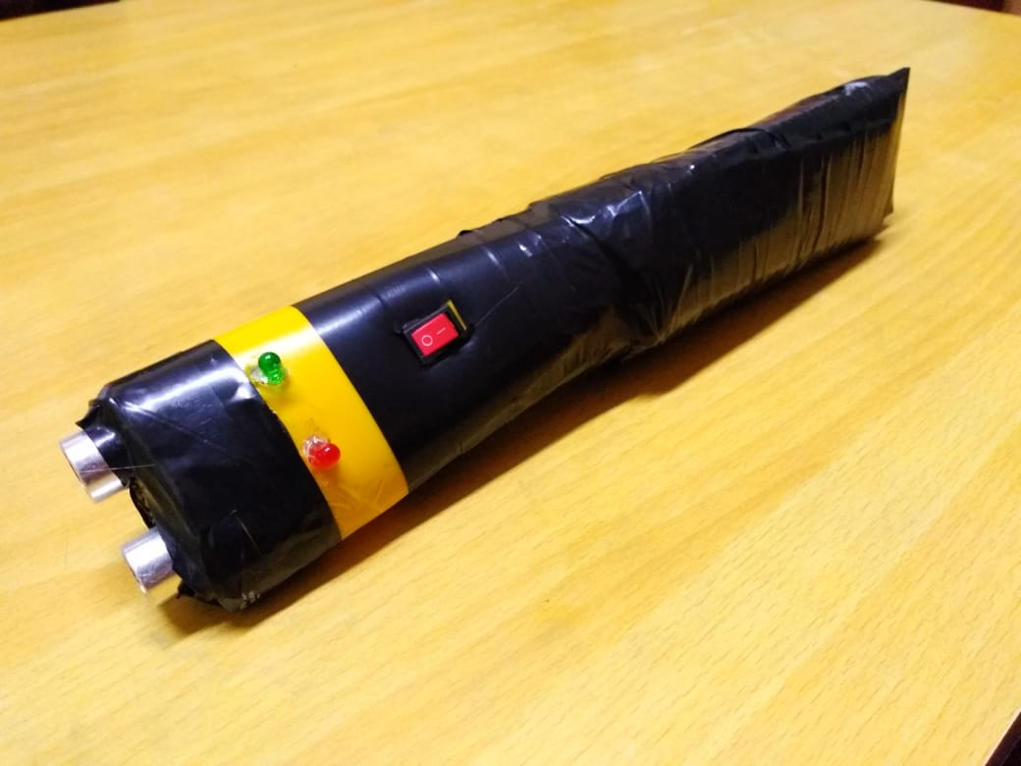
Vision: a Torch for the Visually Impaired
Technomania
Snehesh Dutta
Sinjon Nath
Shouvik Saha
Shivam Shaurya Jha

Slide 2
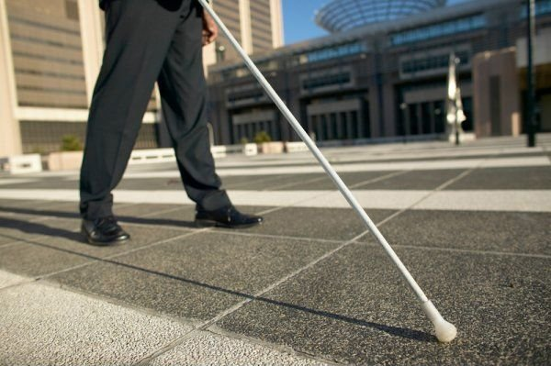
Introduction
Vision is a torch shaped device to help blind people navigate with greater comfort, speed and confidence, whilst making use of ultrasonic waves to detect nearby obstacles and to notify the user through vibrations and beeps of a buzzer.
The idea was inspired from bats, who also use sound waves of high frequency to move.According to an estimate, there are 285 million visually impaired people in the world. The loss of one the most important human senses causes them a lot of hardships in daily life. The affected ones have been using the traditional white cane since many years which although being effective, still has a lot of disadvantages.So the aim of this project is to develop a cheap, yet more efficient way to help the visually impaired navigate with more speed and confidence

Slide 3
Problems Faced in Daily Life
White cane basically a stick made of certain material used by people who are visually impaired as a mobility tool. The trick is to touch the stick at various objects around you and sense them to detect your path. It was first introduced about 100 years ago and since then, it has been the most common way for navigation by the visually impaired. So they are sub-divided into 3 basic types:
Straight Cane
Folding Cane
Telescopic Cane
As described by Cristina Hartman on a question asked on Quora.com: What is it like to be blind?
"As simple as the white cane may be, it still requires training. There are different holds, arcs and contacts. You hold and move it different ways depending on how many people are around you, familiarity of the area; among other factors. The white cane gives you a lot of information, but there are a few things that get me: Chairs and Tables (my cane simply slips underneath), overhanging brush (again, my cane isn't high enough), and cracks (sometimes my cane will bounce back, which is annoying)."
common Disadvantages of White Cane:
May easily crack/break.
Cannot be carried easily.
The stick may get stuck at pavement cracks or different objects.

Slide 4
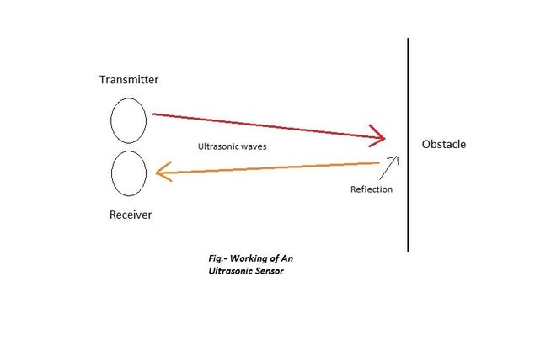
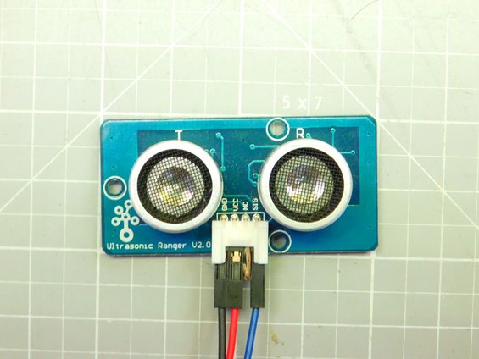
The Concept of SONAR / Use of Ultrasonic Sensors
Ping ultrasonic sensors are the most widely used distance sensors by hobbyists, being relatively cheap and accurate as compared to other sensor types. They work on the principle of SONAR. As seen in the picture, it has two drum shaped objects, one of them is the transmitter while the other one is the receiver. It has a maximum detecting range of 450-500cm, thus will easily serve the purpose of this project.
Why Ultrasonic Sensors?
Accurate calculations.
Can be used inside/outside.
Does not get affected with external sources such as sunlight.
Does not refract/does not pass through.

Slide 5
Components Required
Ultra Sonic Sensor (HC-SR04)
Arduino Nano
Buzzer
Green & Red LEDS
Connecting Wires
External Skeleton
Vibrating Motor
Monotip Switch

Slide 6
kkkkll666bhbjbjbjbjnnoo
Procedure of Making
At first we are taking ultrasonic sensor as a sonar device.
We have connected all the components.
We have written the code required in Arduino IDE.
We have Uploaded the code for proper functioning.

Slide 7
Aim of The Project
To add a third method to the existing lot of two most common navigation techniques by the visually impaired (A simple stick- “The white cane” and A pet dog).
To make a device as small as a handy torch, functional and powered by simple electronics which will solve the above purpose.
To use accurate ultrasonic ranging method by the use of sensors to detect obstacles and to notify the user about their presence near them in different directions through vibrations and sound beeps.
To make it battery operated, long lasting, portable, open source, easily usable and explicit in calculations.
To make the device easily affordable by everyone, the total cost being less.

Slide 8
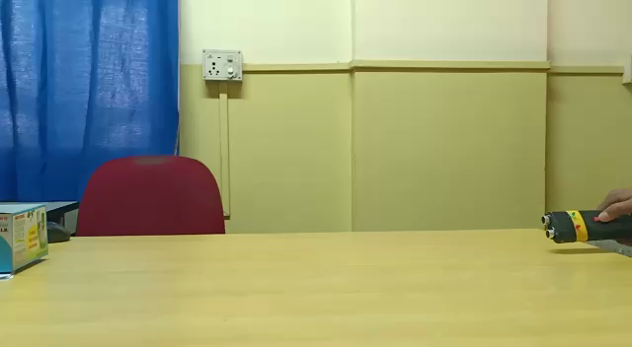
Practical Demostration

Slide 9


